Slide 1

Module 5
Convolutional Neural Networks
Notes:
Guidelines
Use section headers to chunk content in your presentation.
Use the same style of section header throughout your presentation.
Keep your title to no more than 2 lines.

Slide 2
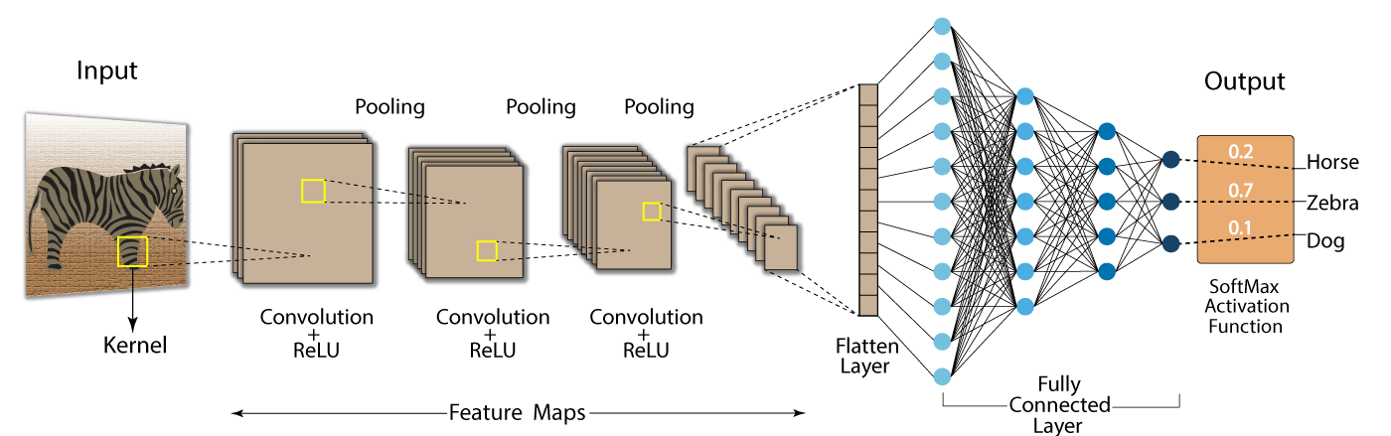
DL: CNNs Pre-Trained Models
Notes:
Guidelines
Use a title slide at the beginning of your presentation. There are 9 variations of title slides to choose from.
If you will have a series of slideshows, we recommend using the same style of title slide for each presentation.
Keep your title to no more than 2 lines.
Do not change the font style or font size of the title or subtitle.

Slide 3

Review: Convolutions
Below is a $\left(3×3\right)$ kernel (convolution) applied to $\left(5×5\right)$ image
Stride is $\left(1,1\right)$

Slide 4
Review: Pooling
A pooling filter is used to downsample the images
min, max and average pooling are the most used.

Slide 5
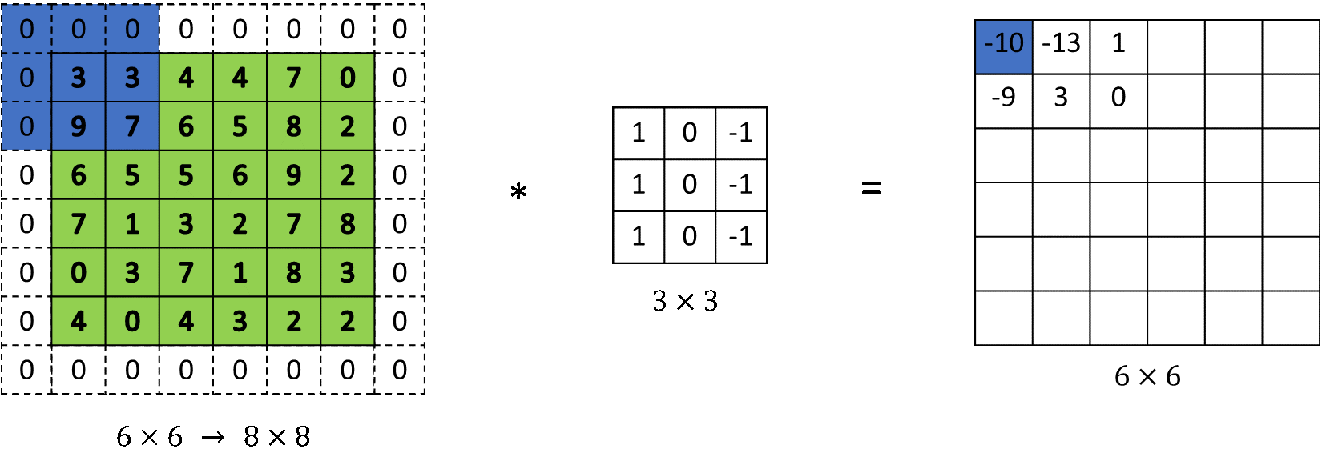
Padding
Used to preserve the spatial dimensions of the input image
Example: adding an extra layer of padding, e.g., padding = 1

Slide 6
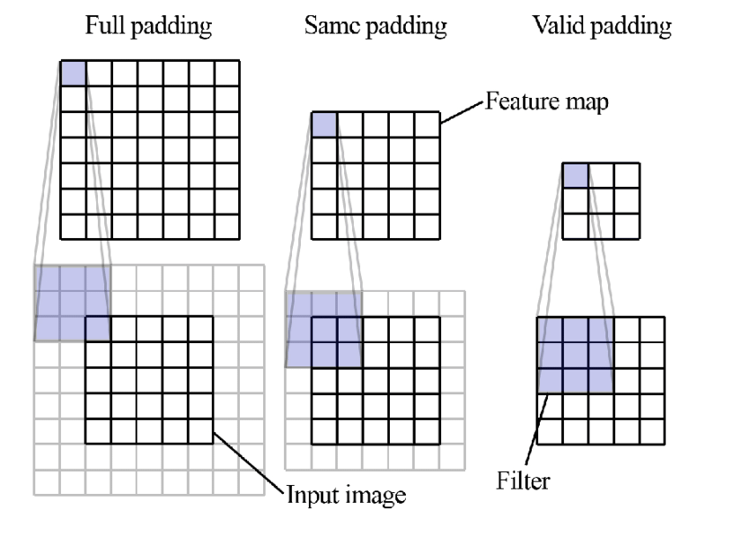
Types of Padding

Slide 7
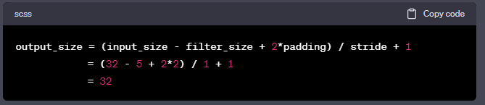
Output Size with Padding and Stride

Slide 8
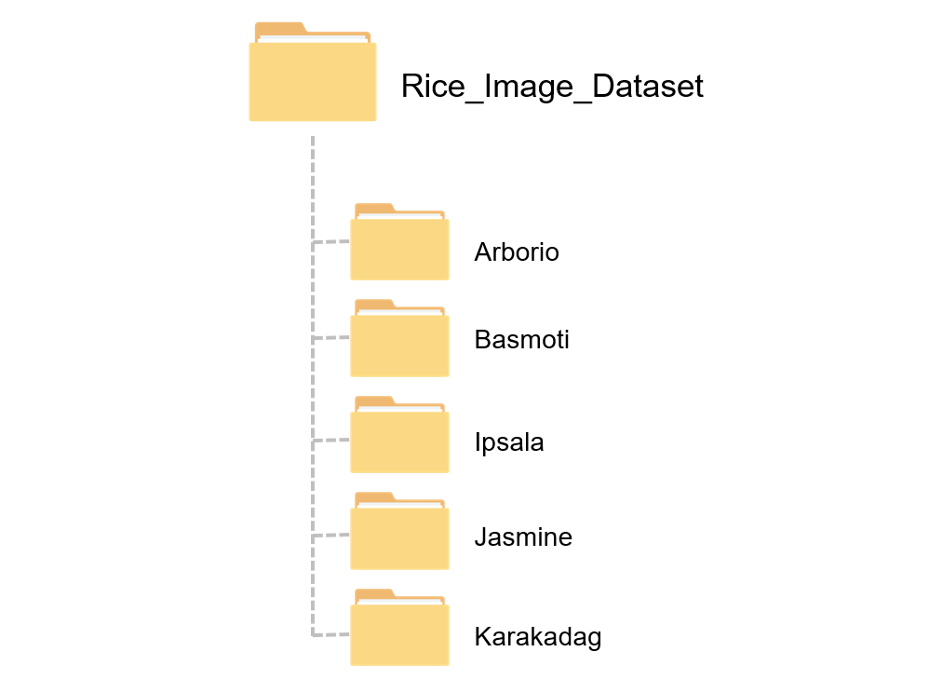
Folder Structure for CNN Training
A typical folder structure for a CNN-based image classification project:
cnn_project/
├── data/
│ ├── train/
│ │ ├── class_1/
│ │ ├── class_2/
│ └── val/
│ ├── class_1/
│ ├── class_2/
├── models/
│ └── saved_model.h5
├── notebooks/
│ └── exploratory_analysis.ipynb

Slide 9
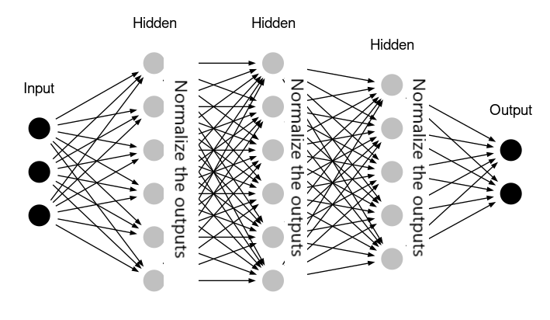
Batch Normalization
Batch normalization is a technique used to improve the training of deep neural networks.
Normalizes the input of each layer to have zero mean and unit variance.
Helps reduce internal covariate shift.
Speeds up training and allows for higher learning rates.
Acts as a form of regularization, sometimes reducing the need for dropout.
Typically applied after linear transformation (e.g., convolution) and before the activation function.

Slide 10
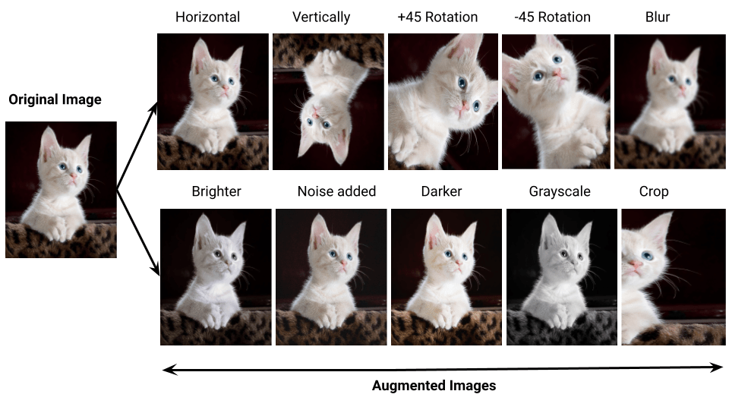
Data Augmentation
Data augmentation is a technique used to increase the size and diversity of training datasets.
Image rotation, flipping (horizontal/vertical)
Cropping and resizing
Brightness and contrast adjustments
Adding noise
Translation and scaling
Cutout and mixup methods

Slide 11
Python
Notes:
Guidelines
Use a title slide at the beginning of your presentation. There are 9 variations of title slides to choose from.
If you will have a series of slideshows, we recommend using the same style of title slide for each presentation.
Keep your title to no more than 2 lines.
Do not change the font style or font size of the title or subtitle.

Slide 12
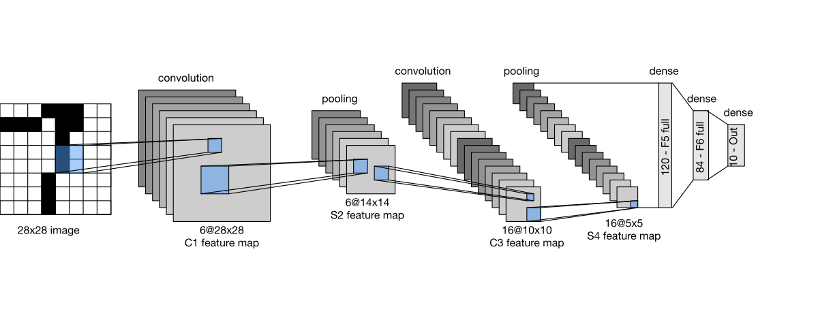
Examples of CNN Architectures
LeNet-5 is a foundational CNN architecture designed for handwritten digit recognition (e.g., MNIST).
Architecture Overview:
1. Input: 32x32 grayscale image
2. C1 - Convolutional layer: 6 filters of size 5x5 → Output: 28x28x6
3. S2 - Downsampling (Avg Pooling): 2x2 → Output: 14x14x6
4. C3 - Convolutional layer: 16 filters → Output: 10x10x16
5. S4 - Downsampling (Avg Pooling): 2x2 → Output: 5x5x16
6. C5 - Fully connected convolution: Output: 120
7. F6 - Fully connected: Output: 84
8. Output Layer: Fully connected with 10 units (for classification)

Slide 13
Examples of CNN Architectures
AlexNet (2012): Introduced ReLU activation, dropout, and GPU training. Won ImageNet 2012.
VGGNet (2014): Uses very small (3x3) filters and a deep architecture (16-19 layers).
GoogLeNet (Inception) (2014): Introduced Inception modules to reduce parameters while maintaining depth.
ResNet (2015): Introduced residual connections to enable very deep networks (e.g., 50,101 layers).
DenseNet (2016): Each layer receives input from all previous layers (dense connectivity).
MobileNet (2017): Lightweight CNN for mobile and embedded vision applications.

Slide 14
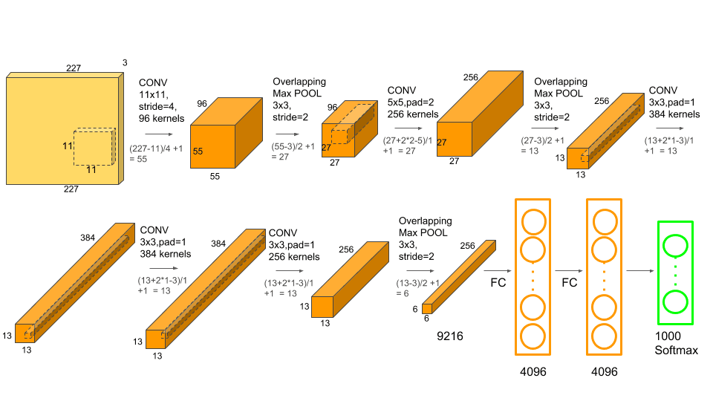
AlexNet

Slide 15
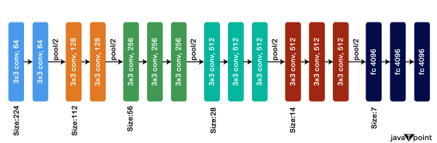
VGGNet

Slide 16
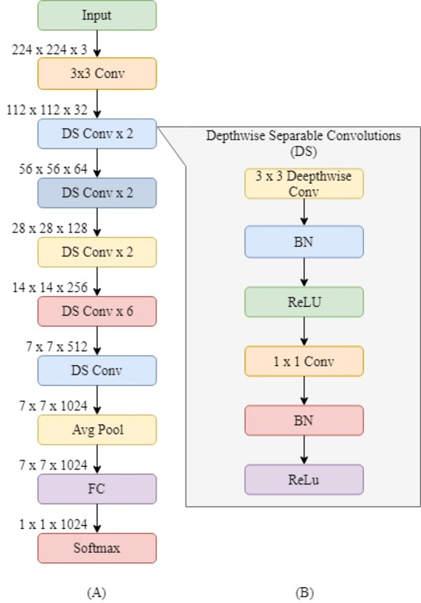
VGGNet

Slide 17
Python
Notes:
Guidelines
Use a title slide at the beginning of your presentation. There are 9 variations of title slides to choose from.
If you will have a series of slideshows, we recommend using the same style of title slide for each presentation.
Keep your title to no more than 2 lines.
Do not change the font style or font size of the title or subtitle.

